Slide 1
Day 3 - Convolutions and Denoising
Some of the figures were generated by ChatGPT

Slide 2
HW Review
Solutions to Day 2 HW

Slide 3
Recap of Day 2
Vectors can be seen both as arrows in space or as ordered lists of numbers
Adding vectors is either done head-to-tail, or just by adding the values
Scaling the vectors is either changing the length or multiplying the values
To take the dot product of two vectors you multiply and add the components of two vectors
A matrix is a 2D grid of values
Adding and scaling matrices work the same way as vectors
Matrix-vector multiplication is more convoluted - so we do it with code
Images are stored as matrices
Grayscale images have values between [0,1] and color images have RGB vectors

Slide 4
Convolutions Continued

Slide 5
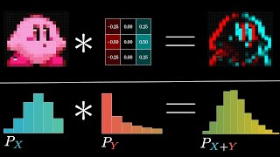
What is a convolution in image processing?
Go to 8:58
From 3Blue1Brown

Slide 6
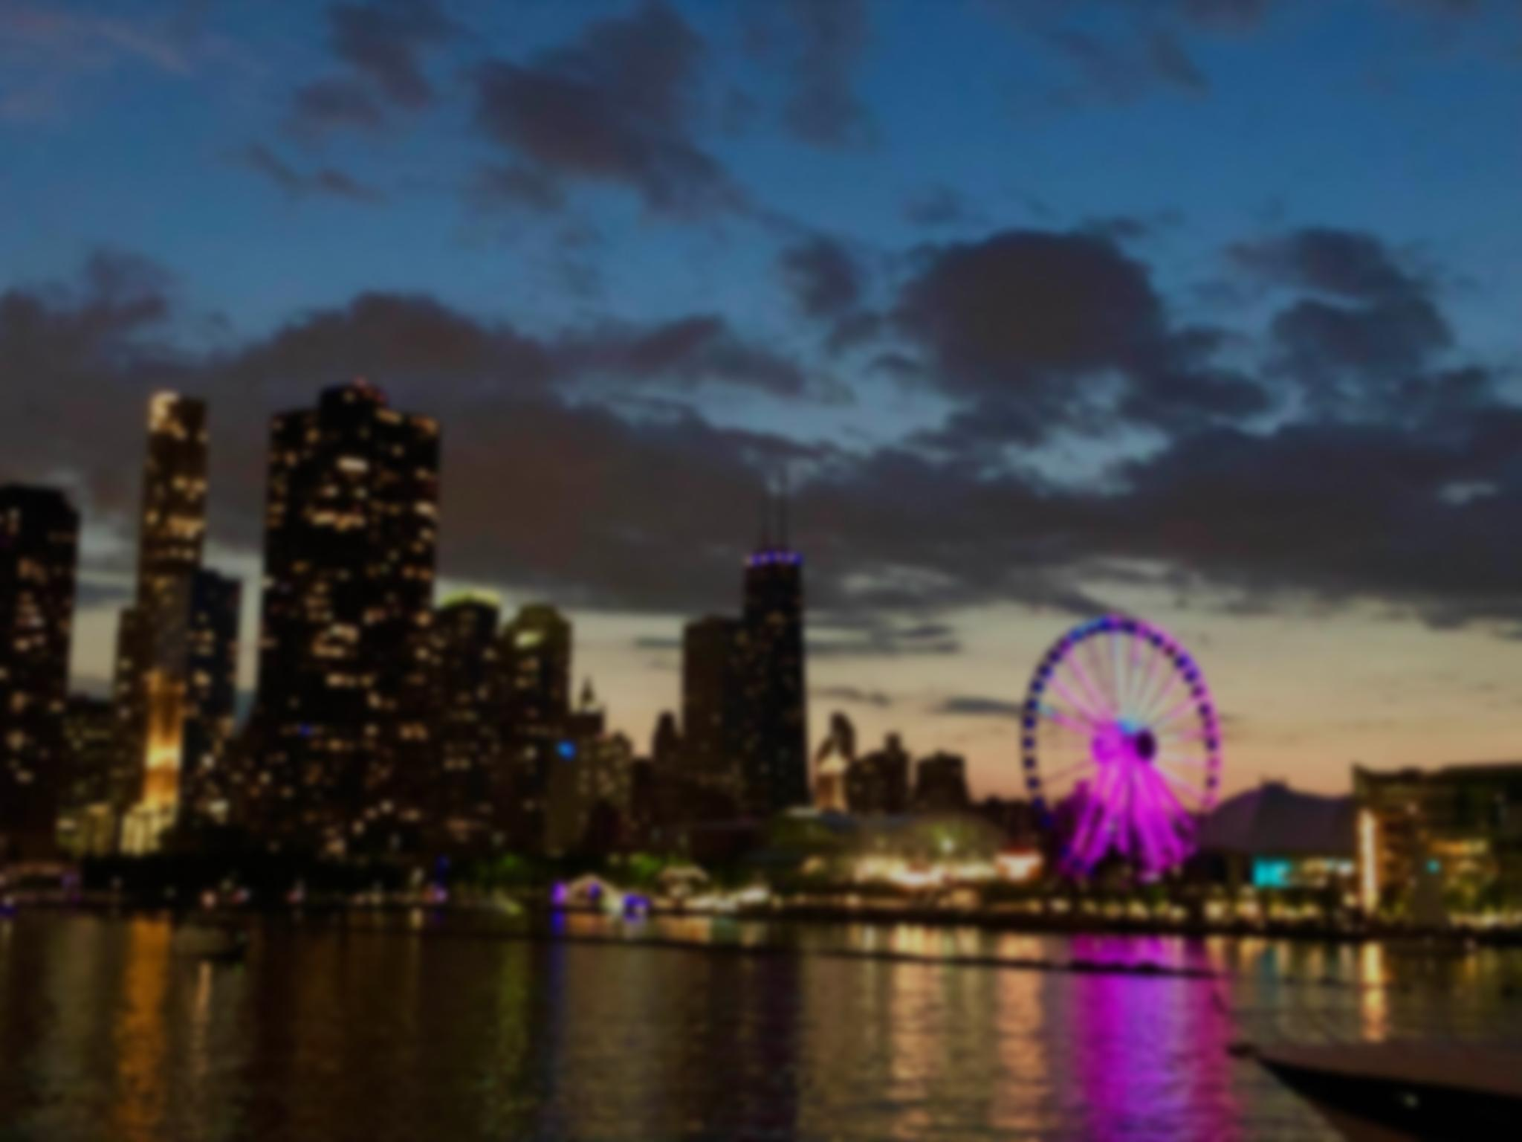
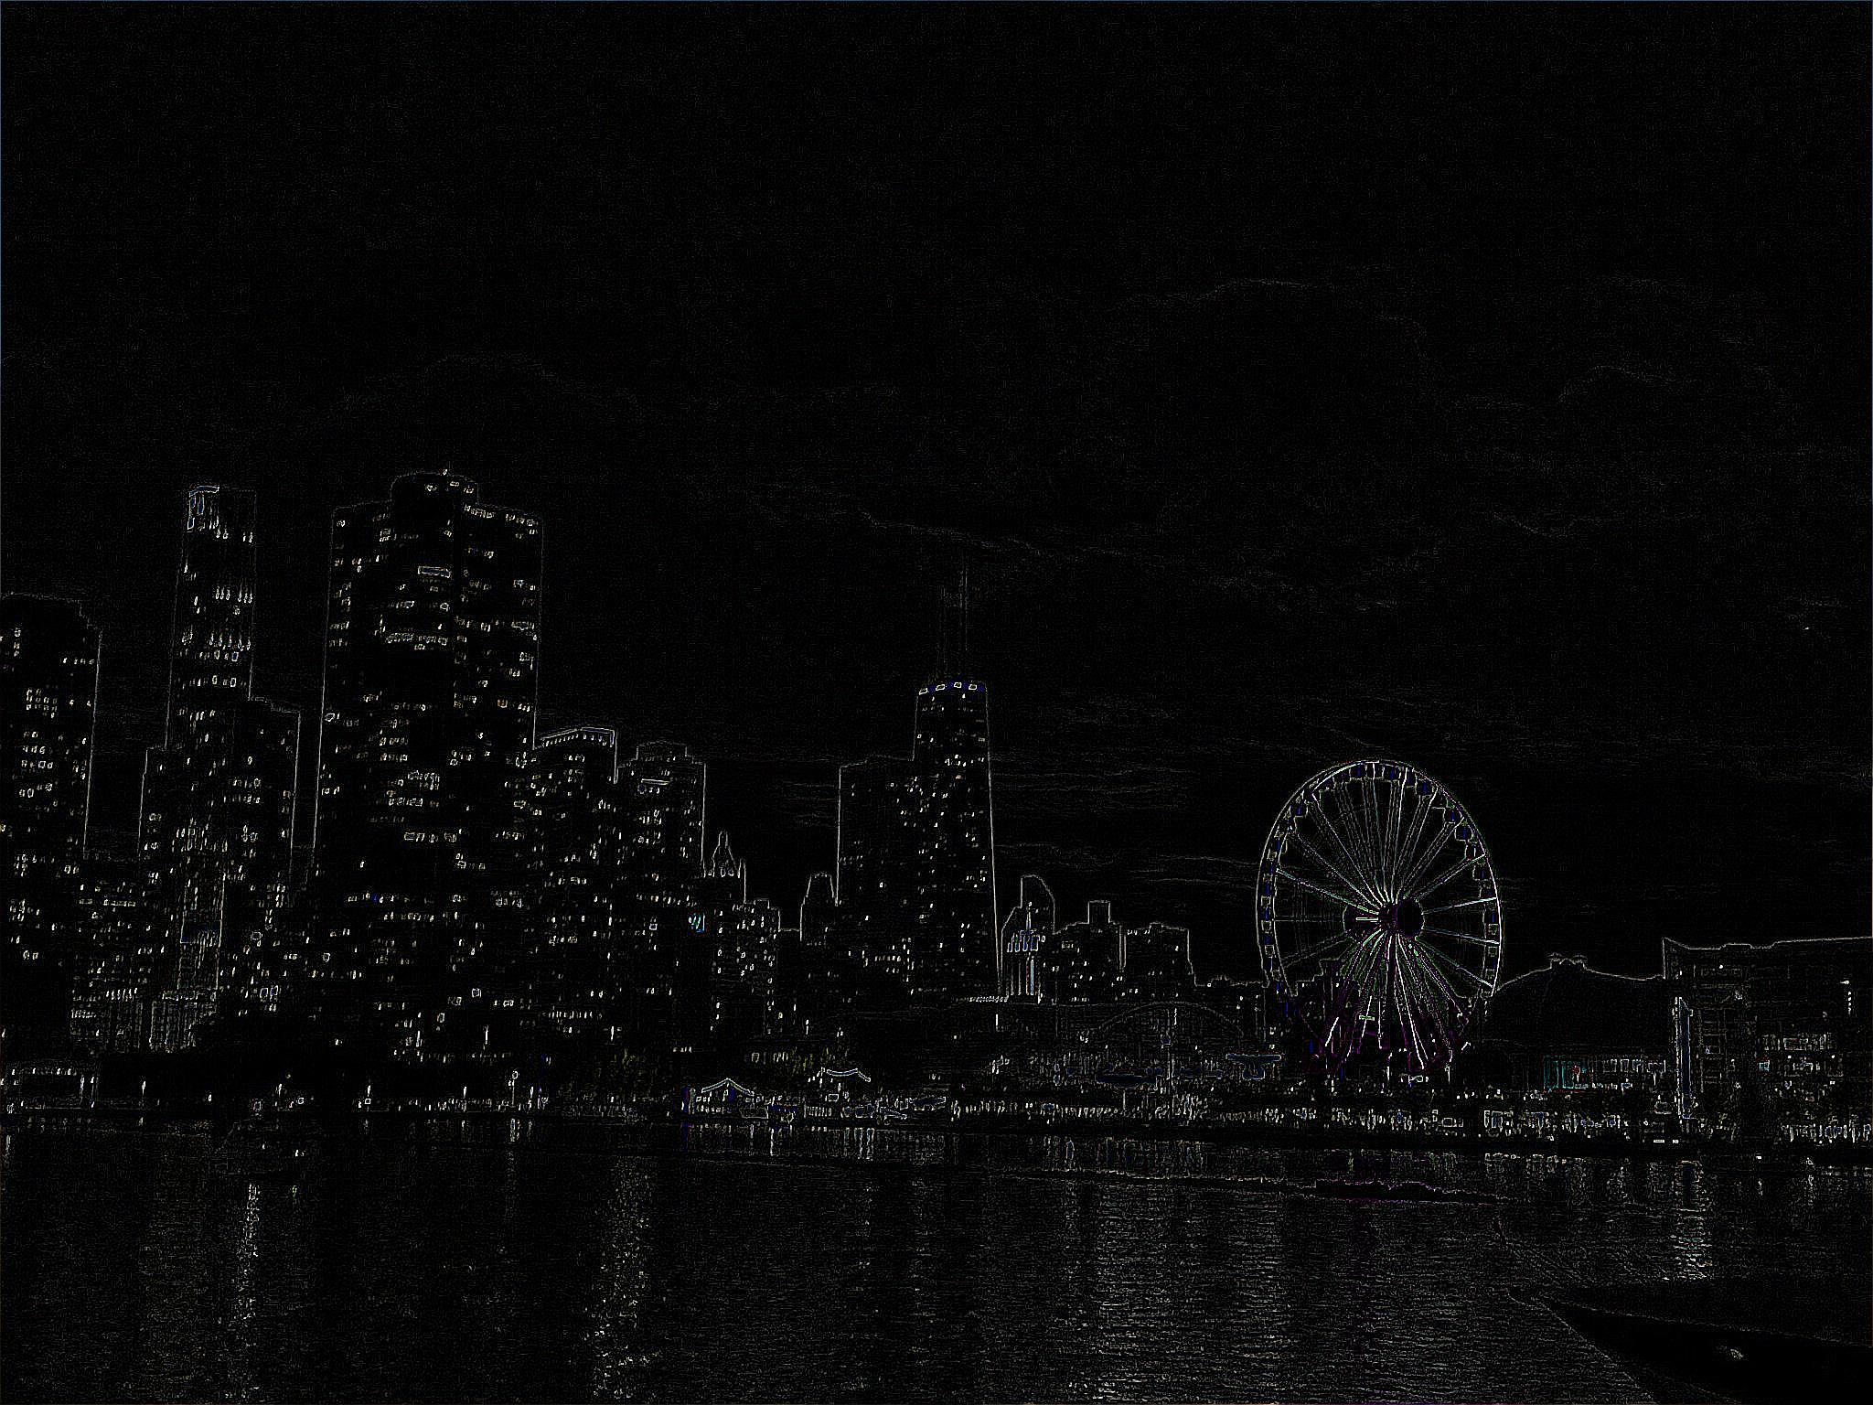
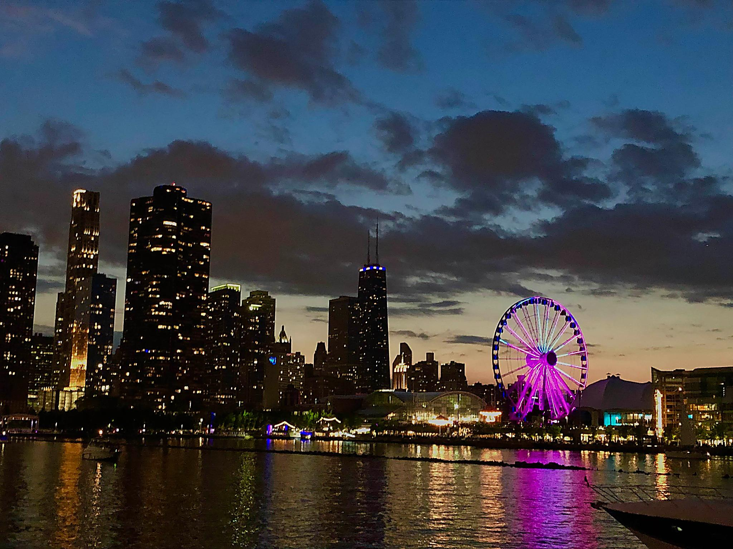
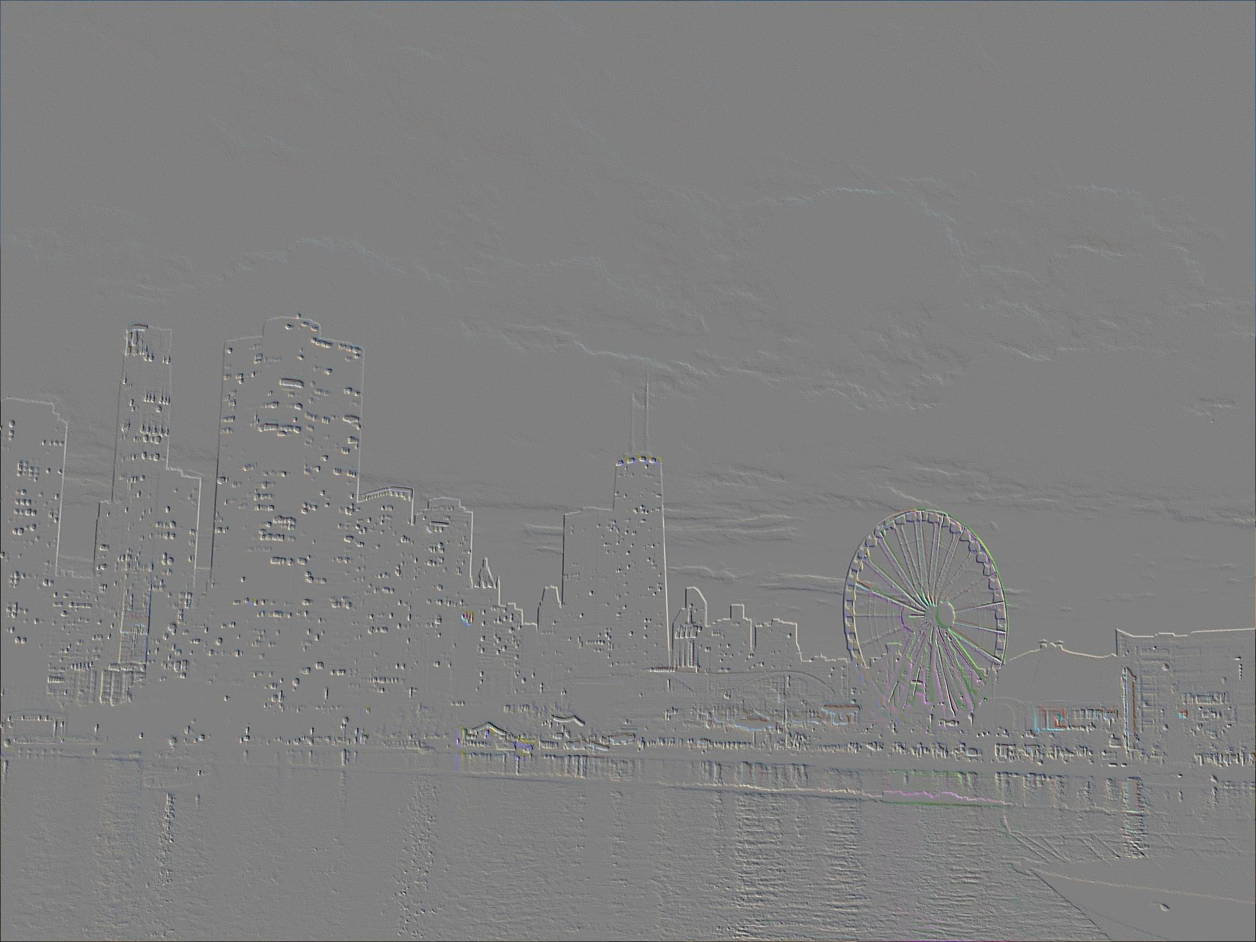
Examples of what Convolutions can do
Blurring
Outline
Sharpen
Emboss

Slide 7
Convolutions in image processing involve two parts: the image and the kernel
The image is the image
The kernel is a small grid of values that will march along the image
When the kernel overlays the image, the values in the pixel values will be multiplied by corresponding kernel values and be summed together–this is the dot product of the kernel and the section of the image
That new value will be what goes into the new image

Slide 8
Messing around with convolutions
https://setosa.io/ev/image-kernels/
This site lets you play around with different kernels and convolutions and clearly see what is happening.

Slide 9
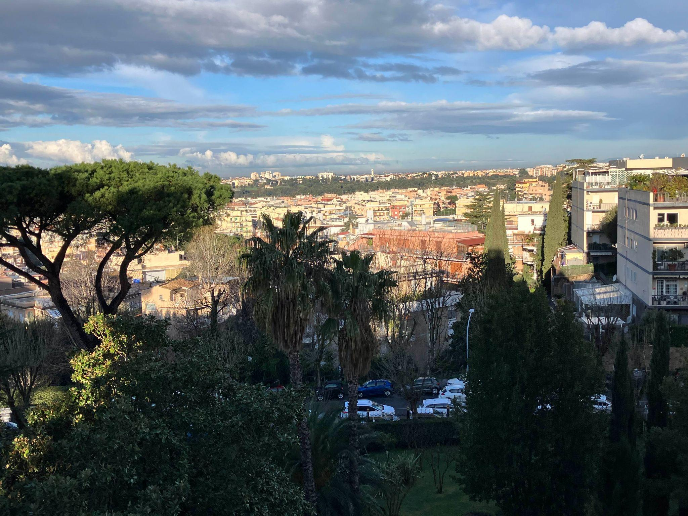
But there is an issue: if the kernel must fully overlay the image, what happens at edges?
This is the kernel
Since the kernel would take in values that aren’t defined, the convolution won’t work.
One solution is to not convolve the edges, but there is another way.

Slide 10
To solve the edges issue, we pad the image.
Padding an image is the process of adding extra layer(s) to the image so that the edges are also convolved.
There are different ways to pad:
Most commonly zero-padding is used. This adds extra layer(s) of 0’s to the edge of the image - (ask students) If this is the case, how will that affect the convolution?
Replication-padding is where the extra layers replicate the original edges.
Circular-padding is where the extra layers are the opposite edges, treating the image like it circles

Slide 11
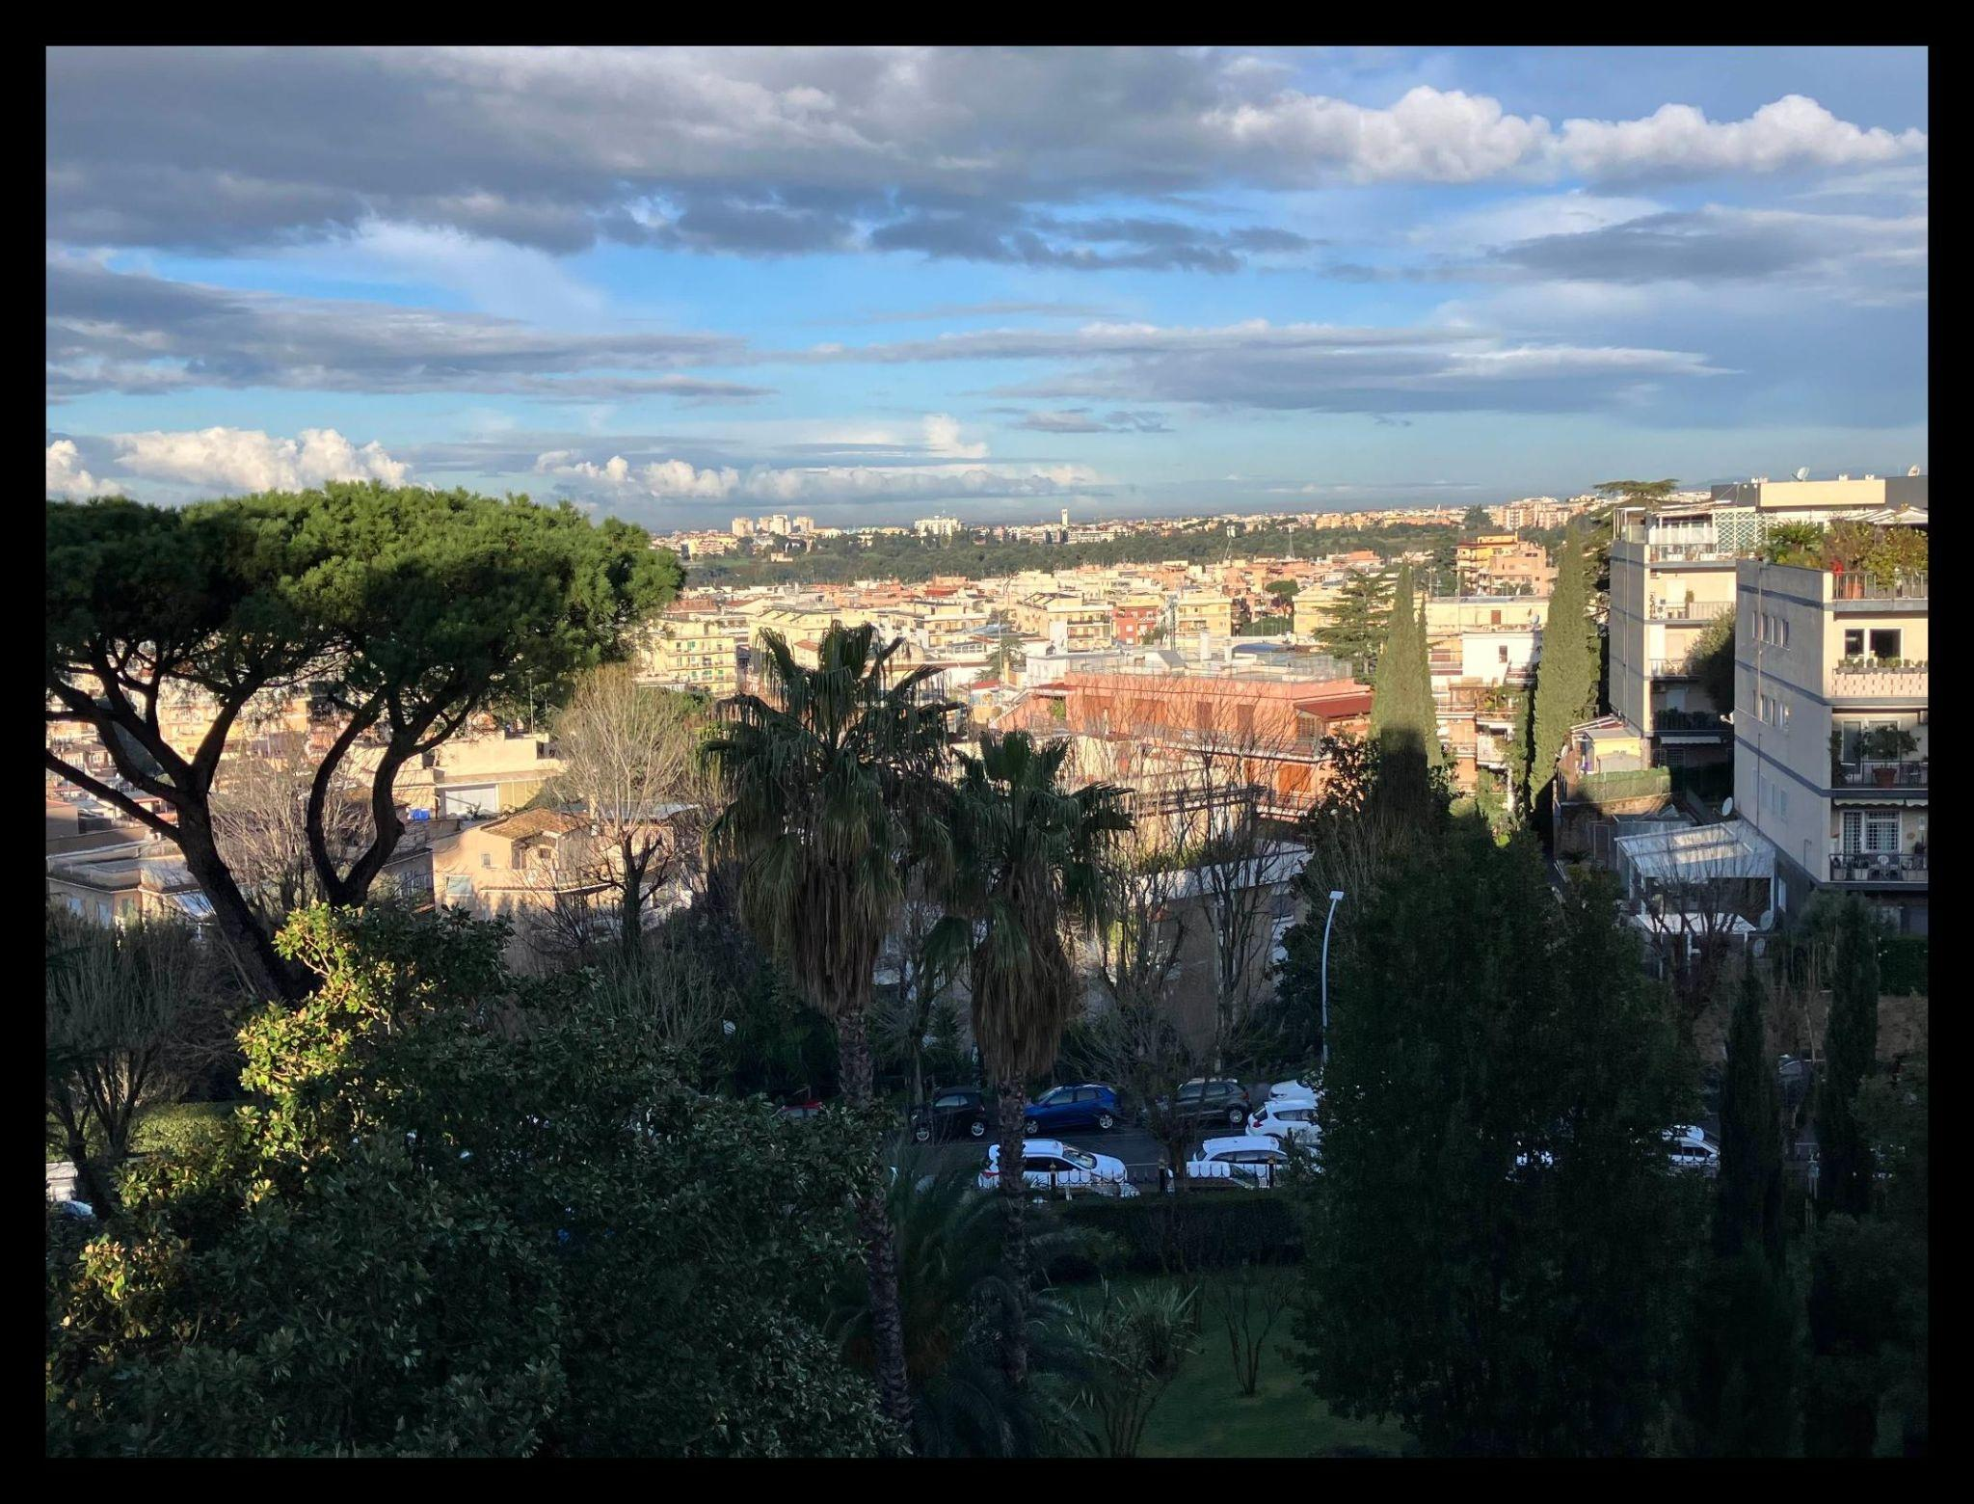
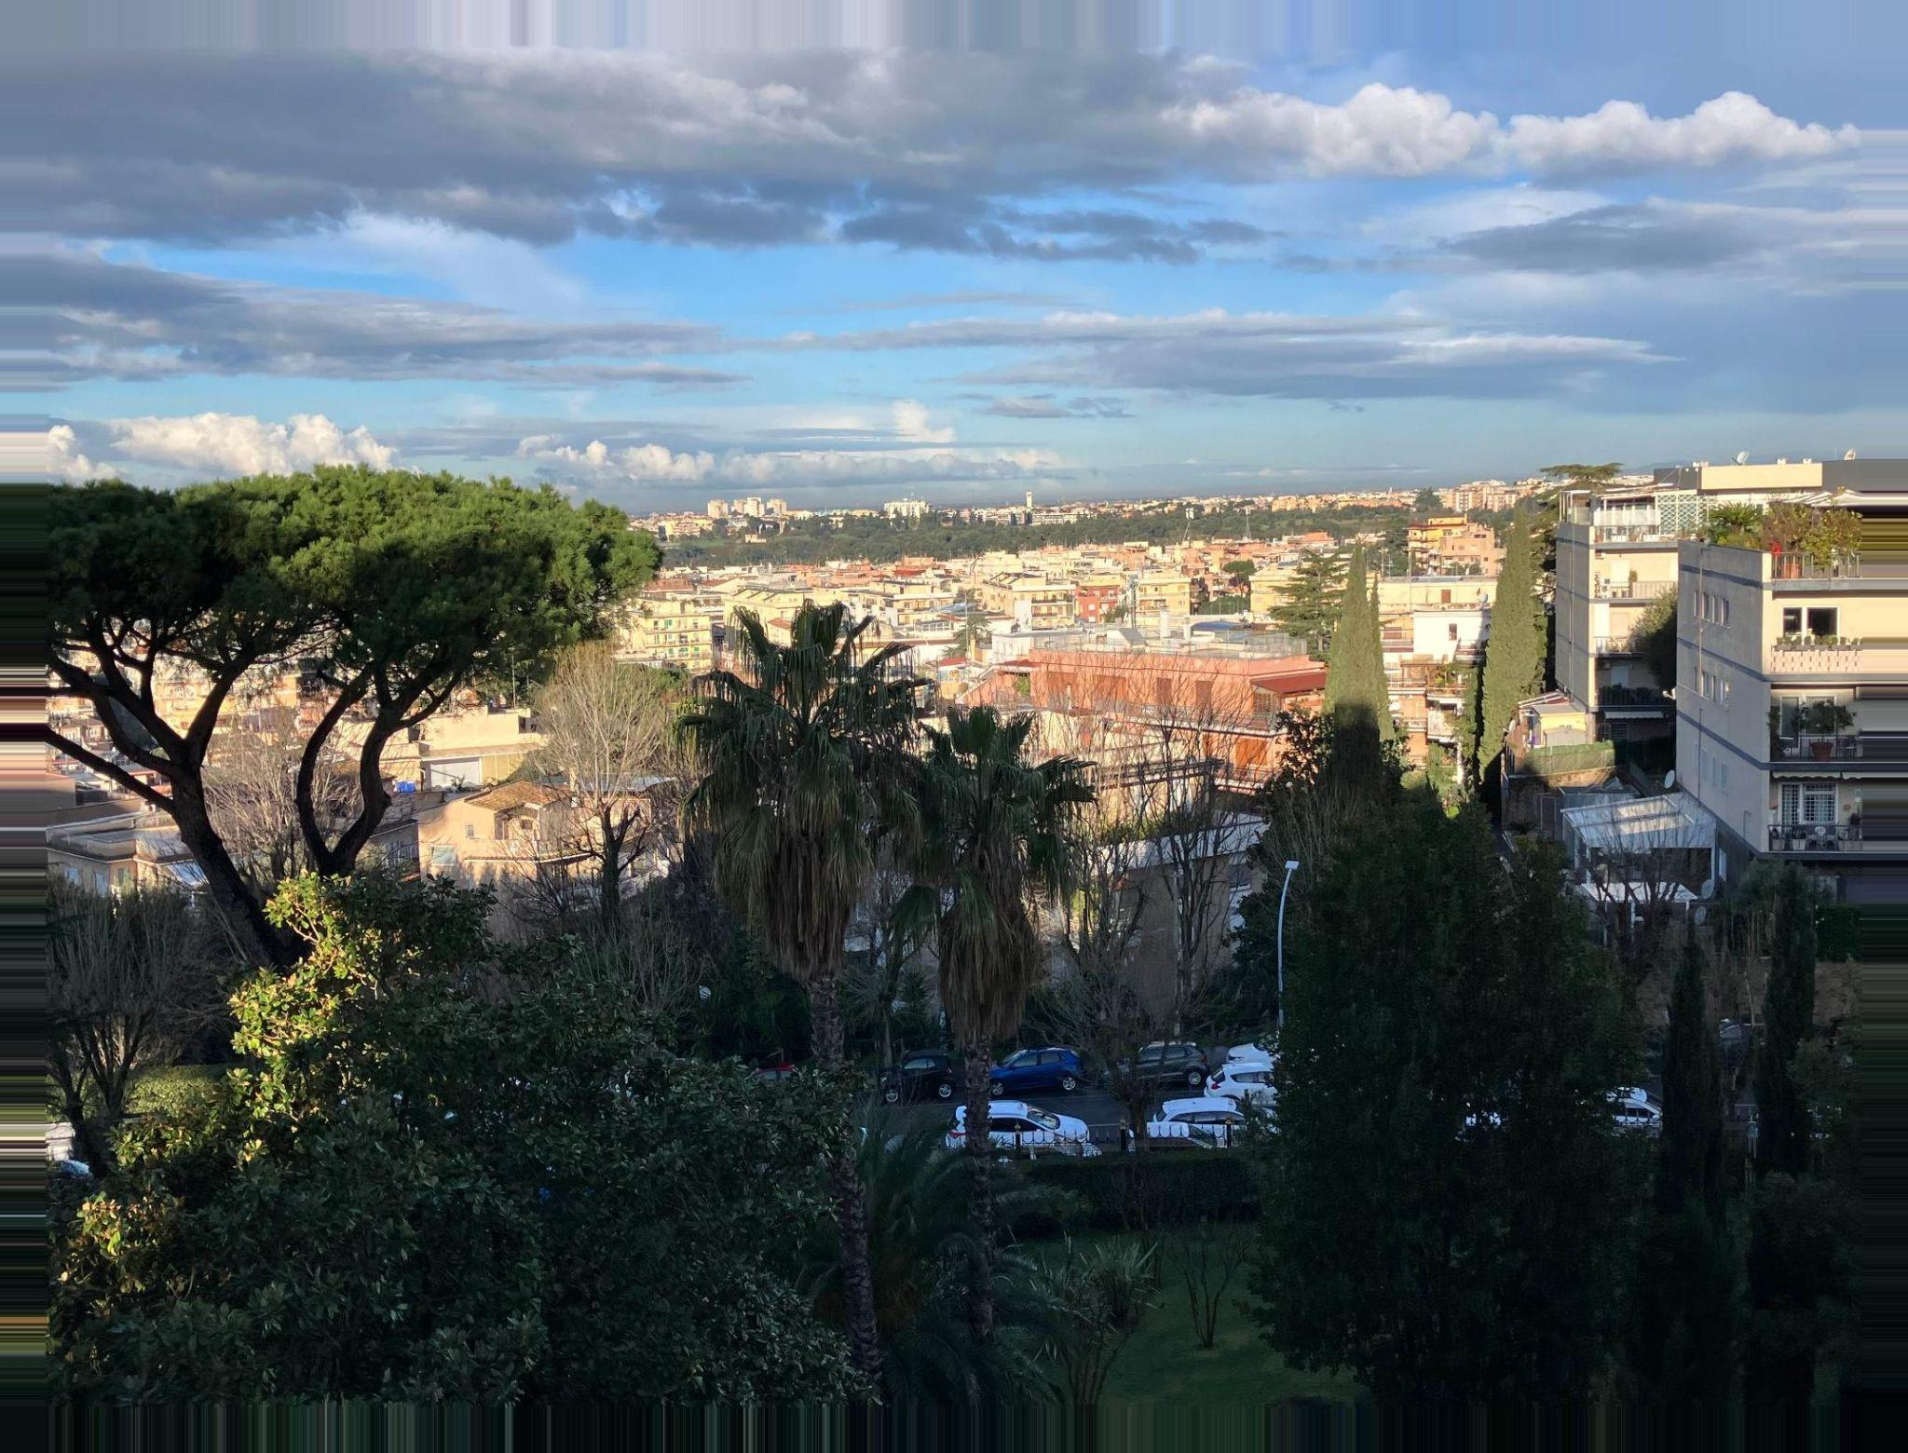
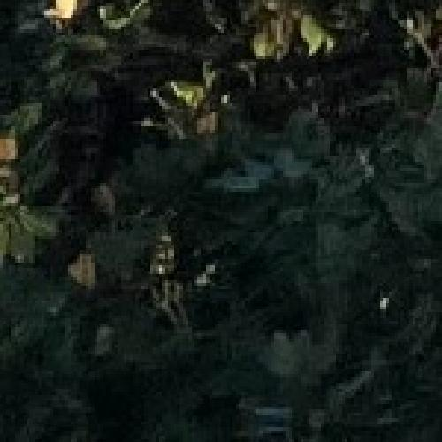
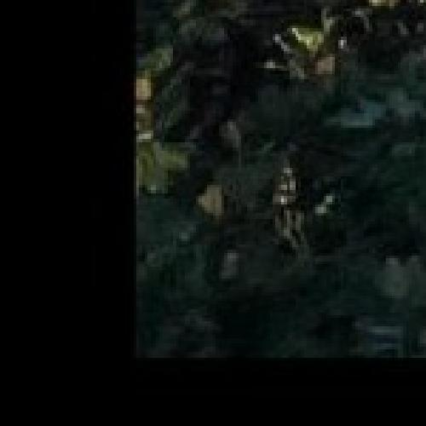
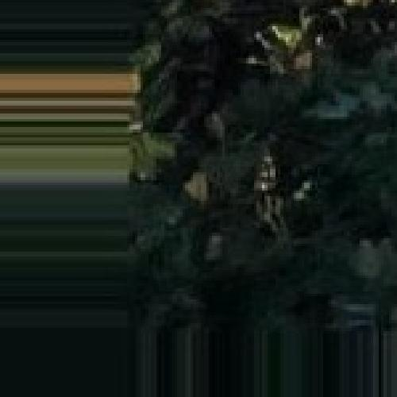
Padding Examples
Original
Zero-Padding
Replication Padding

Slide 12
Recap
Convolutions (something about what they let us do with images)
They take two parts: an image and a kernel
The kernel marches along the images and performs dot products to create a new image
To avoid dimensionality issues, we pad the original image. Padding is the process of adding extra layers to the original image.

Slide 13
Convolutions with Code
Notebook

Slide 14
Noise

Slide 15
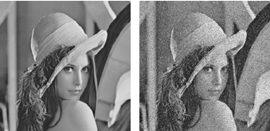
Noise is unwanted random variation that distorts the image
Original
Noisy
You can also have noise in other forms: ex. static noise in songs

Slide 16
There are different types of noise
Here are some common ones:
Salt and Pepper Noise: random pixels become either fully white or black
Poisson Noise: random variations generated from different amounts of light hitting the camera
Gaussian Noise: what the next couple slides are about

Slide 17
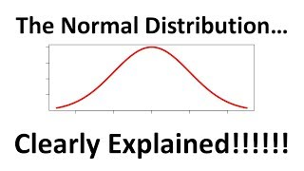
Gaussian Noise is based on the Gaussian Distribution
The Gaussian Distribution, also called the Normal Distribution or a Bell Curve, shows how values are spread out around a mean (an average).
The gaussian distribution has two parts: the mean, and the standard deviation
The mean is the average value
The standard deviation is how much the rest of the values deviate from the mean
From StatQuest with Josh Starmer

Slide 18
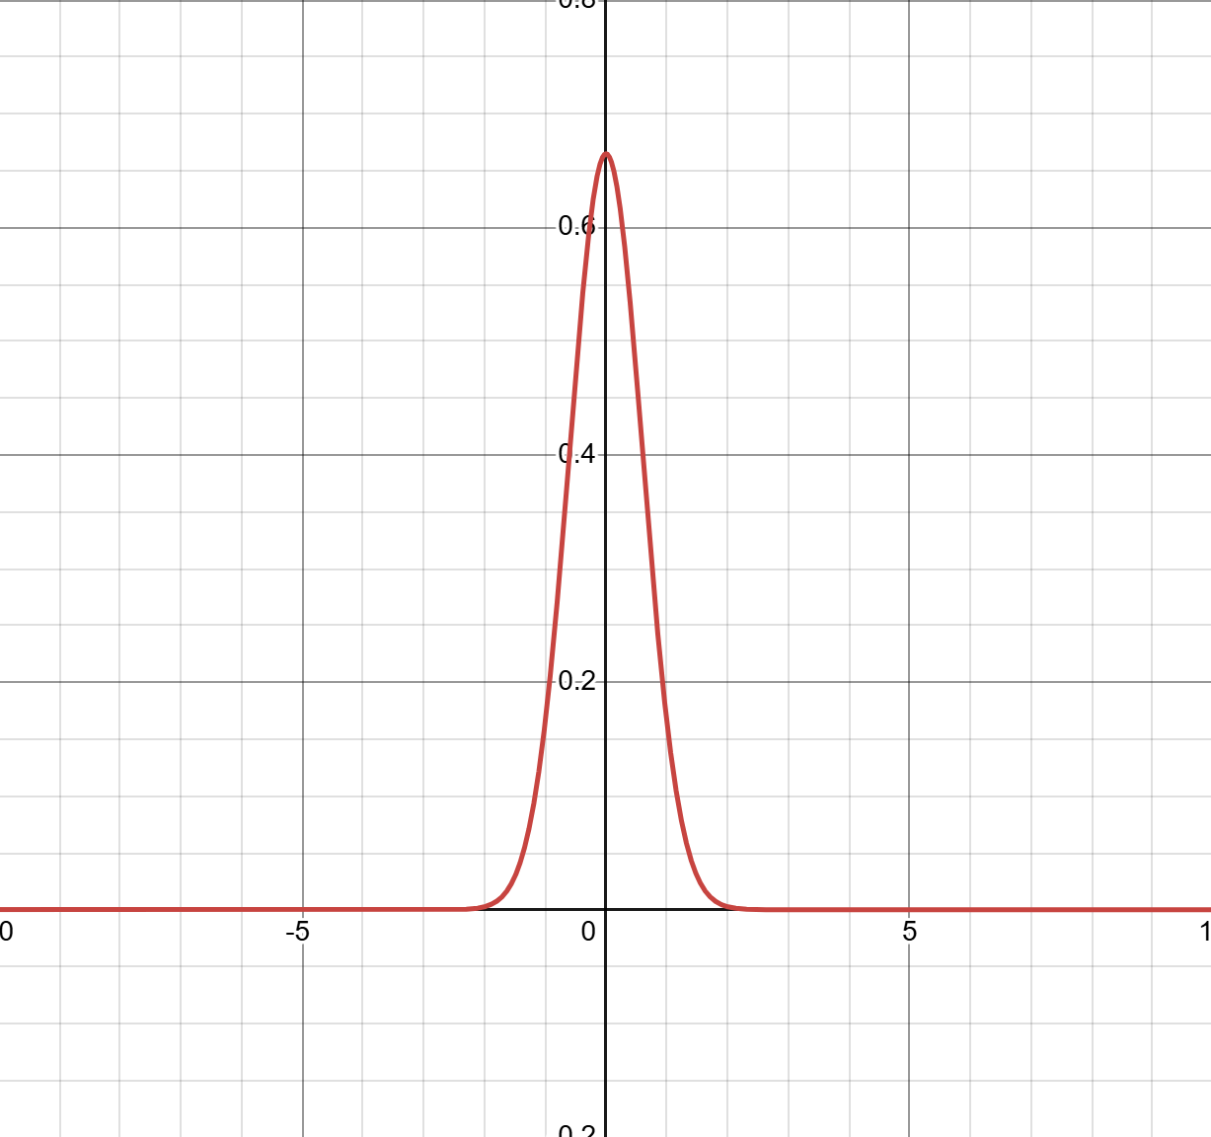
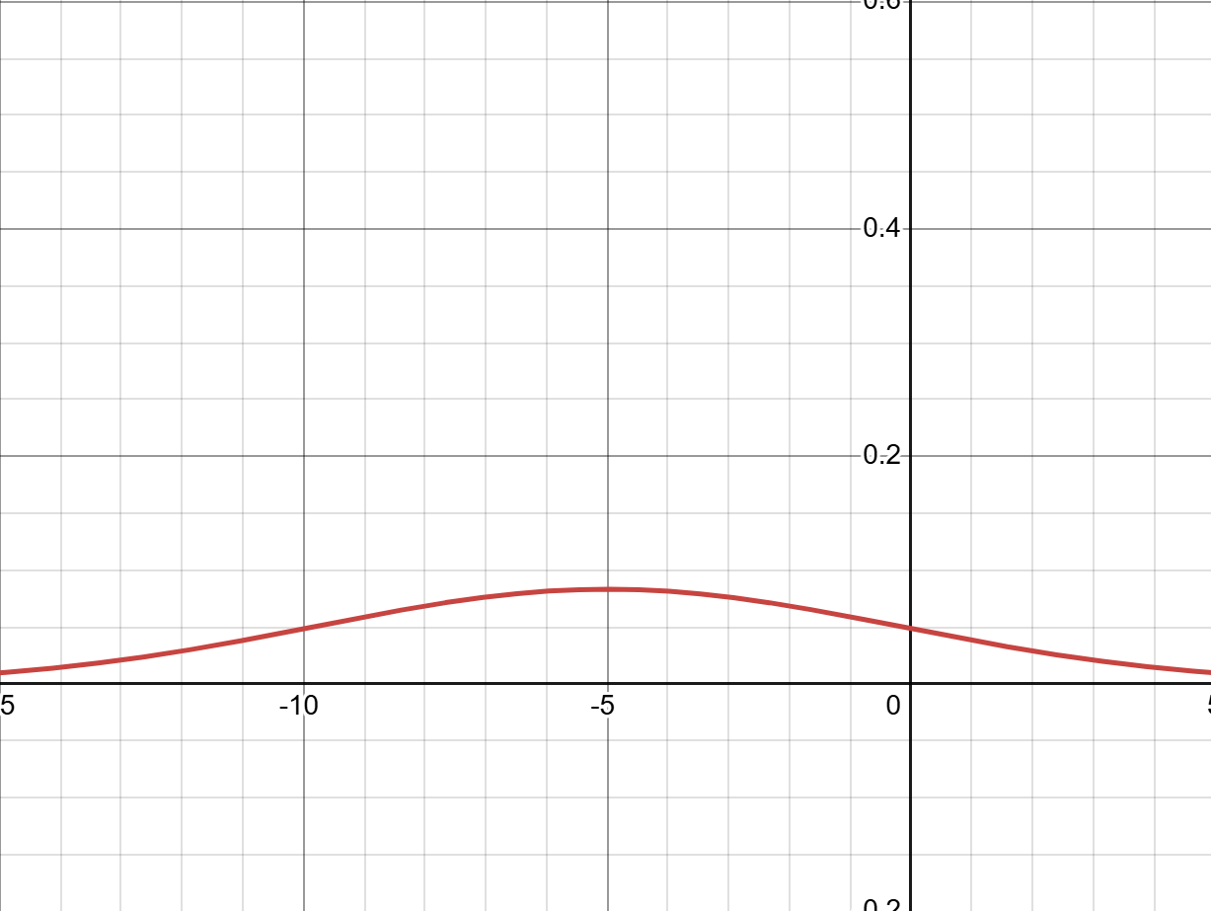
The mean and standard deviation graphically
Graphs from Desmos
This distribution’s mean is -5
The standard deviation is high, since the values are more spread out.
This distribution’s mean is 0, since that is where the average value is.
The standard deviation is low, the values are close to the average.

Slide 19
Sampling from a Gaussian Distribution is the process of randomly getting a value
When you sample a Gaussian Distribution–randomly get a value–you get one of the x-values with a probability that is proportional to the height.

Slide 20
Gaussian Noise is noise sampled from a Gaussian Distribution
For images, at every pixel the gaussian distribution is sampled with a mean of 0 and some standard deviation, and that is how much is either added or subtracted from the image.
This happens because of small errors in machinery which happen to fit a gaussian distribution.
The mean is 0 because on average the added or subtracted noise cancel out, but the standard deviation is dependent on the items being used.

Slide 21
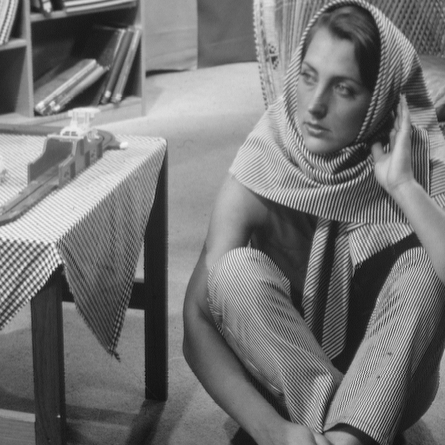

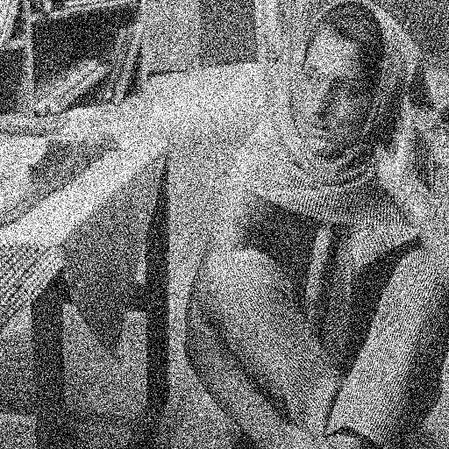
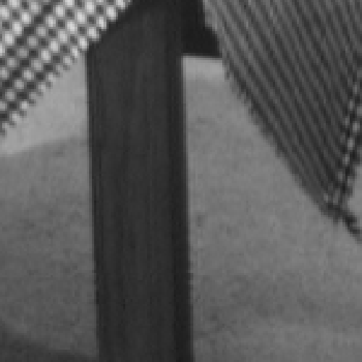
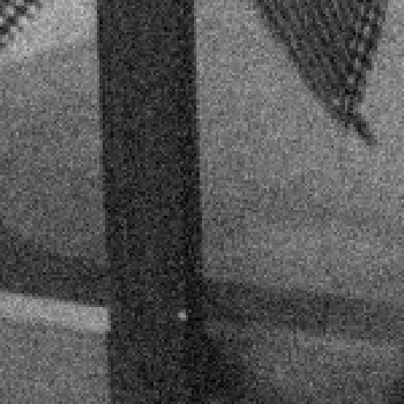
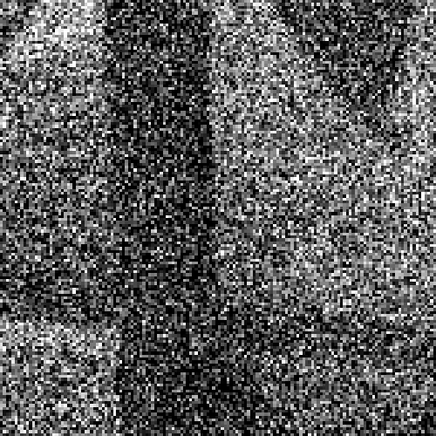
Gaussian Noise Examples
Original
Standard Deviation of 0.05
Standard Deviation of 0.3

Slide 22
Visualizing Noise with Code
Notebook

Slide 23
Denoising

Slide 24
Denoising is the process of removing noise
The challenge in denoising is that noise is random, so we can’t just pinpoint noise on an image and remove it.
But, as we have seen, we often know the distribution of noise
So, our algorithms use our knowledge of the noise distribution to remove it

Slide 25
To denoise Gaussian noise we blur the image
Blurs smooth images - neighboring values are averaged. Since noise is small, random bumps, that have a mean of 0, when noisy pixels are averaged the random bumps cancel out.
However, this comes at a cost - blurring also makes image blurry (who would’ve guessed).
This is an unavoidable caveat with this method - there are better methods that are more complicated, so we won’t go into them. But you are encouraged to look into them on your own time if you are interested.

Slide 26


Denoising Examples
Original
Noisy Image
Denoised
The noise has been reduced, but the image is blurrier now.

Slide 27
Denoising with Code
Notebook

